Slide 1
Tree

Slide 2
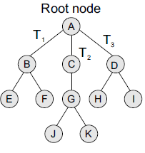
INTRODUCTION
A tree is recursively defined as a set of one or more nodes where one node is designated as the root of the tree and all the remaining nodes can be partitioned into non-empty sets each of which is a sub-tree of the root.
Figure shows a tree where
node A is the root node;
nodes B, C, and D are children of the root node and form sub-trees of the tree rooted at node A.
Uses
Stores natural hierarchical data (file system)
Help to organize data and perform efficient operation (search, sort, eg BST)
Used to design and implement Network routing algorithm
Represent and store algebraic expression

Slide 3
Tree Terminology
Root: node without parent (A)
Siblings: nodes share the same parent
Internal node: node with at least one child (A, B, C, F)
External node (leaf ): node without children (E, I, J, K, G, H, D)
Ancestors of a node: parent, grandparent, grand-grandparent, etc.
Descendant of a node: child, grandchild, grand-grandchild, etc.
Depth of a node: number of ancestors
Height of a tree: maximum depth of any node
Degree of a node: the number of its children
The leaf of the tree does not have any child so its degree is zero
Degree of a tree: the maximum degree of a node in the tree.
Subtree: tree consisting of a node and its descendants
Empty (Null)-tree: a tree without any node.
Root-tree: a tree with only one node
A
B
C
D
E
F
G
H
I
J
K

Slide 4
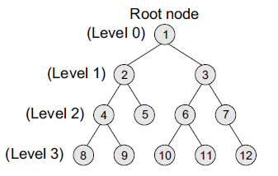
Binary Trees
It is a data structure that is defined as a collection of elements called nodes.
In a binary tree,
the topmost element is called the root node, and
Each node has 0, 1, or at the most 2 children.
A node that has zero children is called a leaf node or a terminal node.
Every node contains a data element, a left pointer which points to the left child, and a right pointer which points to the right child.

Slide 5
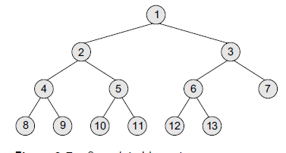
Complete Binary Trees
A complete binary tree is a binary tree that satisfies two properties.
First, in a complete binary tree, every level, except possibly the last, is completely filled.
Second, all nodes appear as far left as possible.

Slide 6
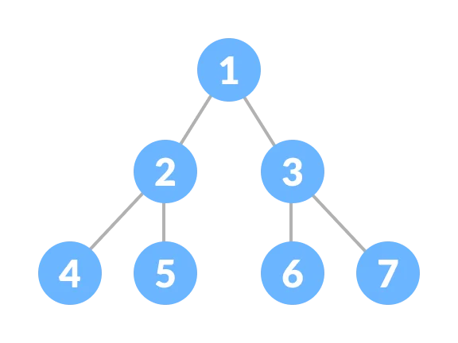
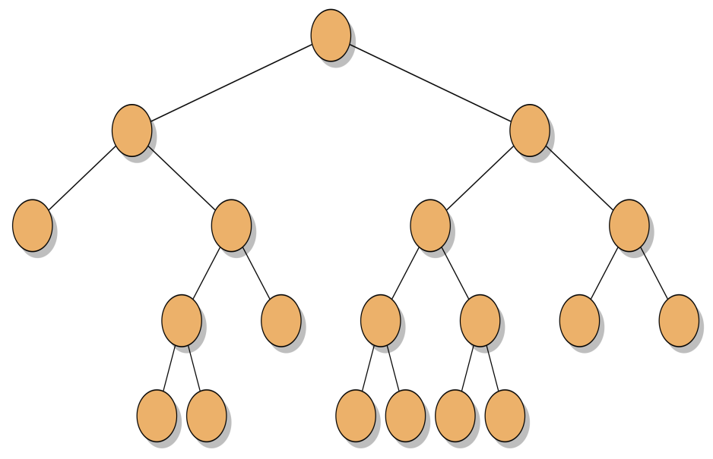
Perfect binary tree
A perfect binary tree is a type of binary tree in which every internal node has exactly two child nodes and all the leaf nodes are at the same level
Full binary tree
A full binary tree can be defined as a binary tree in which all the nodes have 0 or two children. In other words, the full binary tree can be defined as a binary tree in which all the nodes have two children except the leaf nodes

Slide 7
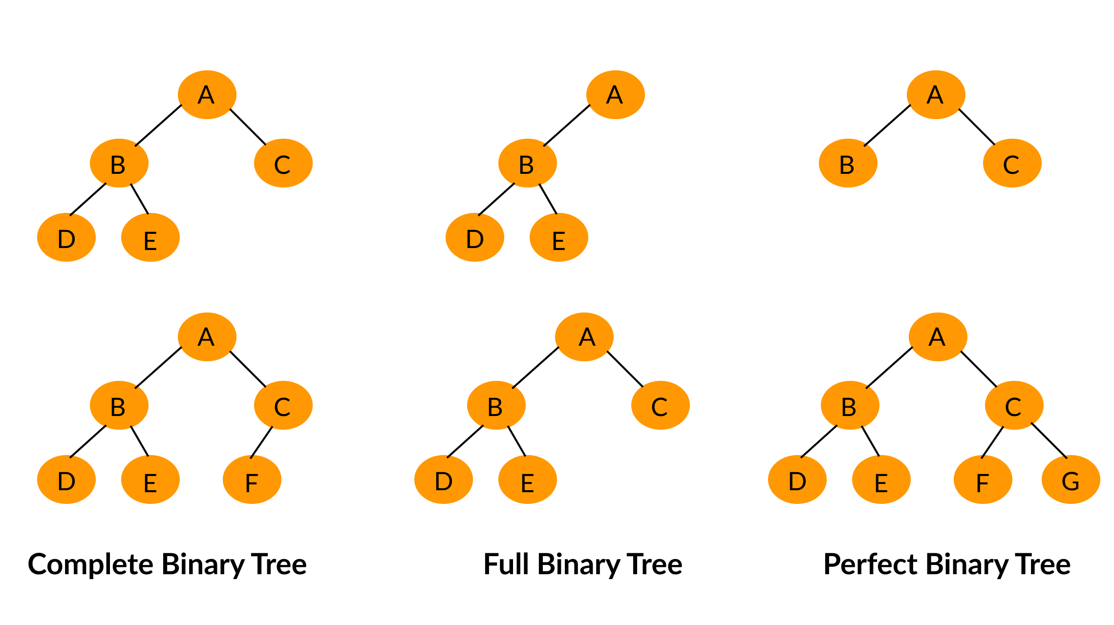
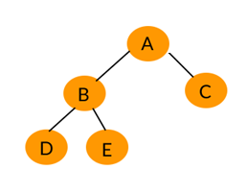

Slide 8
Representation of Binary Trees

Slide 9
Representation of Binary Trees in the Memory
Linked representation of binary trees
In the linked representation, every node will have three parts:
the data element, a pointer to the left node, and a pointer to the right node.
So in C++, the binary tree is built with a node type given below.
class node {
node *left;
int data;
node *right;
};
Every binary tree has a pointer ROOT, which points to the root element (topmost element) of the tree. If ROOT = NULL, then the tree is empty.

Slide 10
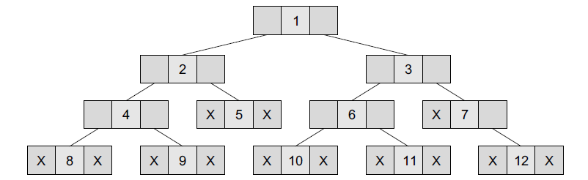
Linked representation of binary trees

Slide 11
Sequential representation of binary tree
Sequential representation of trees is done using single or one-dimensional arrays. Though it is the simplest technique for memory representation, it is inefficient as it requires a lot of memory space.
A sequential binary tree follows the following rules:
A one-dimensional array, called TREE, is used to store the elements of tree.
The root of the tree will be stored in the first location. That is, TREE[1] will store the data of the root element.
The children of a node stored in location K will be stored in locations (2 × K) and (2 × K+1).
The maximum size of the array TREE is given as (2^{h+1}–1), where h is the height of the tree.
An empty tree or sub-tree is specified using NULL. If TREE[1] = NULL, then the tree is empty.

Slide 12
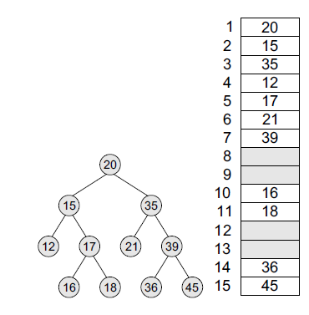
Array Implementation of a binary tree
For any node k
The left child of a node K = 2 × K
The right child of a node K = 2 × K+1
Parent of any node K = floor (K/2)

Slide 13
Traversing a Binary Tree
Traversing a binary tree is the process of visiting each node in the tree exactly once in a systematic way.
Unlike linear data structures in which the elements are traversed sequentially, tree is a non linear data structure in which the elements can be traversed in many different ways. (ex. LNR, LRN, NLR)
There are different algorithms for tree traversals. These algorithms differ in the order in which the nodes are visited.

Slide 14

Pre-order Traversal
To traverse a non-empty binary tree in pre-order, the following operations are performed recursively at each node. The algorithm works by:
1. Visiting the root node,
2. Traversing the left sub-tree, and finally
3. Traversing the right sub-tree.
The pre-order traversal of the tree is given as A, B, C.

Slide 15
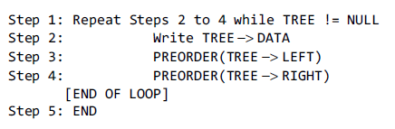
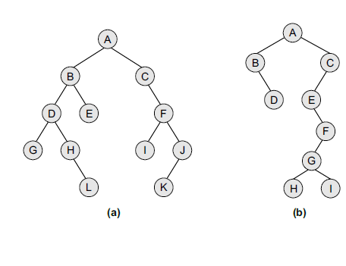
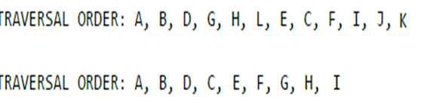
Algorithm for Pre-Order

Slide 16
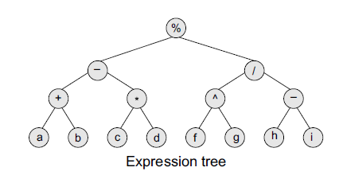
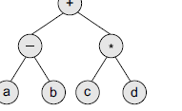
Pre-order traversal algorithms are used to extract a prefix notation from an expression tree.
For example, consider the expressions given below. When we traverse the elements of a tree using the pre-order traversal algorithm, the expression that we get is a prefix expression.
+ – a b * c d
% – + a b * c d / ^ f g – h i

Slide 17
In-order Traversal
To traverse a non-empty binary tree in in-order, the following operations are performed recursively at each node. The algorithm works by:
1. Traversing the left sub-tree,
2. Visiting the root node, and finally
3. Traversing the right sub-tree.

Slide 18
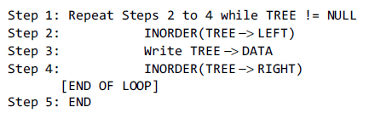
Algorithm for In-Order

Slide 19
Post-Order Traversal
To traverse a non-empty binary tree in post-order, the following operations are performed recursively at each node. The algorithm works by:
1. Traversing the left sub-tree,
2. Traversing the right sub-tree, and finally
3. Visiting the root node.

Slide 20
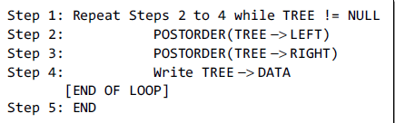
Algorithm for Post-Order

Slide 21
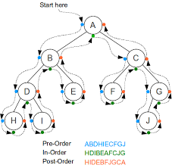

Slide 22
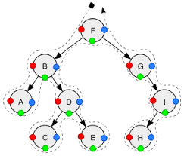

Slide 23
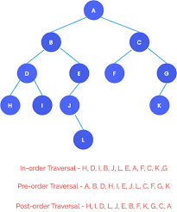

Slide 25
Constructing Binary Tree Using Traversal Orders
Construct Tree
Determine Postorder of following tree
=> Preorder – A B D G H L E C F I J K
=> Inorder - G D H L B E A C I F K J
Postorder ?

Slide 26
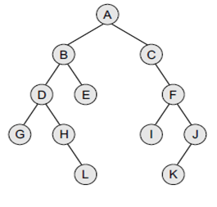

Preorder – A B D G H L E C F I J K
Inorder - G D H L B E A C I F K J
Postorder

Slide 27
Constructing Binary Tree Using Traversal Orders
Construct Tree
Determine Preorder of following tree
=> Postorder – G L H D E B I K J F C A
=> Inorder - G D H L B E A C I F K J
Preorder ?

Slide 28
Constructing Binary Tree Using Traversal Orders
=> Postorder – G L H D E B I K J F C A
=> Inorder - G D H L B E A C I F K J
Preorder ?
A B D G H L E C F I J K

Slide 29


Construct Tree using following Traversals

Slide 30
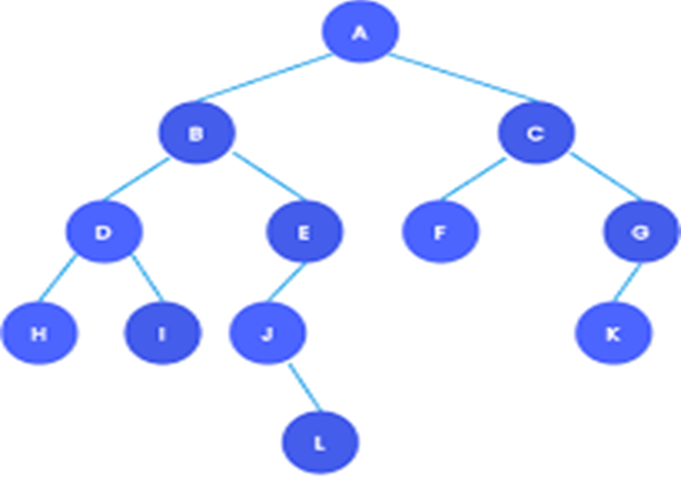
Construct Tree using following Traversals

Slide 31
Constructing Binary Tree Using PostOrder Traversal & PreOrder Traversal

Slide 32
Constructing Binary Tree Using Traversal Orders
=> Postorder – G L H D E B I K J F C A
Preorder -
Inorder ?
A B D G H L E C F I J K

Slide 33
Constructing Binary Tree Using Traversal Orders
=> Postorder – G L H D E B I K J F C A
Preorder -
Inorder ?
A B D G H L E C F I J K
G D H L B E A C I F K J

Slide 34


Slide 36
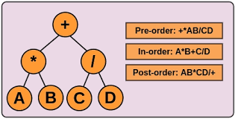
Understanding Expression Trees

Slide 37
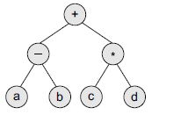
Expression Tree
Binary trees are widely used to store algebraic expressions.
For example, consider the algebraic expression given as:
Exp = (a – b) + (c * d)

Slide 38
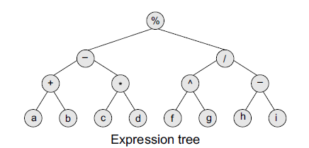
Given an expression, Exp = ((a + b) – (c * d)) % ((f ^g) / (h – i)), construct the corresponding binary tree.

Slide 39
Pre-order traversal algorithms are used to extract a prefix notation from an expression tree.
For example, consider the expressions given below. When we traverse the elements of a tree using the pre-order traversal algorithm, the expression that we get is a prefix expression.
+ – a b * c d
% – + a b * c d / ^ f g – h i

Slide 40
Significance of Prefix, Postfix and Infix Notation
Infix → (a – b) + (c * d)
Prefix → + – a b * c d

Slide 41
Construct expression tree for following
a + b / c * d - e
a * b / c + d / e * f + g – h * i
[a+(b-c)]*[(d-e)/(f+g-h)]
[a+(b*c)]-(d/e)
[(a+b)-(c*d)]%[(e^f)/(g-h)]
(a+b)*(c*d-e)*f/g
(((a*b)*c)*d)

Slide 42
Construct expression tree
a + b / c * d - e
a * b / c + d / e * f + g – h * i
(a + b) * (c * d - e) * f / g

Slide 43
Construct Expression Tree
from
Prefix Notation
Prefix → + – a b * c d

Slide 44
Construct Expression tree from Prefix Notation
Prefix → + – a b * c d
% – + a b * c d / ^ f g – h i

Slide 45
Construct Expression Tree
from
Postfix Notation
Postfix → a b - c d * +

Slide 46
Construct Expression tree from Postfix Notation
a b + c d * - f g ^ h i - / %

Slide 47
Video Lecture of the topic can be found at
Introduction to TREE Data Structures
https://youtu.be/QIIu27tfdG8
Binary Trees and It Representation in Memory
https://youtu.be/0k1gZ7m8WUk
Traversing a Binary Tree - PREORDER, POSTORDER & INORDER TRAVERSAL
https://youtu.be/H0exHo7KAhQ
Constructing Binary Tree using Given Traversing Sequences
https://youtu.be/wee7con8IkU
Constructing Binary Tree using PostOrder and PreOrder Traversals
https://youtu.be/RvO5oRqrJ3I
Understanding Expression Tree data structure
https://youtu.be/qPoS1iM2JXY
Constructing Expression Tree from Postfix notation
https://youtu.be/WjnGmJ3zd58
Constructing Expression tree from Prefix Notation
https://youtu.be/e3WERX_uW3w

